Slide 1
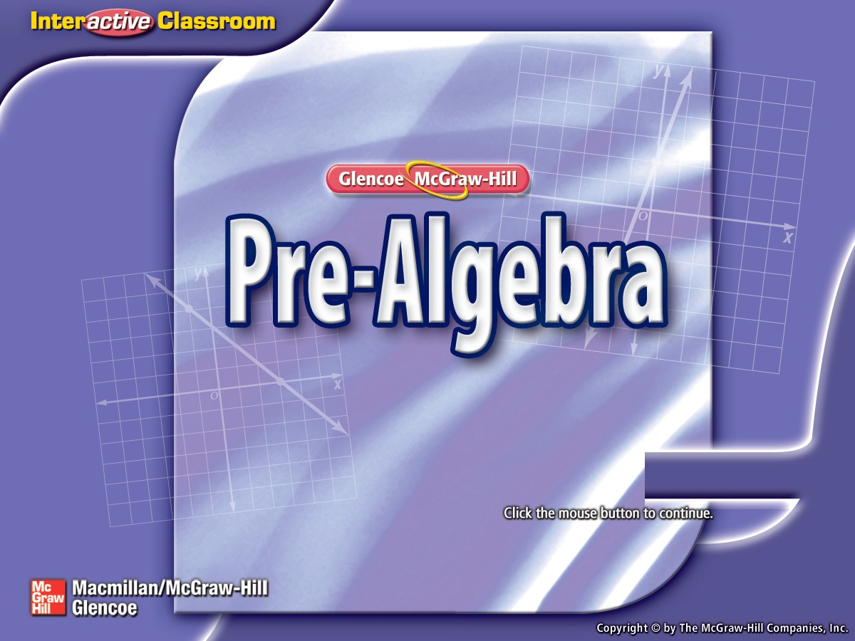
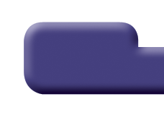

Splash Screen

Slide 2
Lesson Menu
Five-Minute Check (over Lesson 6–6)
Then/Now
New Vocabulary
Key Concept: Similar Triangles
Example 1: Find Measures of Similar Figures
Example 2: Real-World Example: Find Measures of Similar Figures

Slide 3

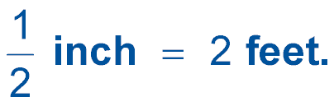
5-Minute Check 1
On a floor plan for a new house, the scale is
Find the actual length of the
master bedroom which is 5 inches on the floor plan.
A. 20 feet
B. 15 feet
C. 10 feet
D. 5 feet

Slide 4


5-Minute Check 2
On a floor plan for a new house, the scale is
Find the actual length of the
living room which is inches on the floor plan.
A. 14.5 feet
B. 14 feet
C. 13.5 feet
D. 13 feet

Slide 5

5-Minute Check 3
On a floor plan for a new house, the scale is
Find the actual length of the
kitchen which is 2.8 inches on the floor plan.
A. 12 feet
B. 11.5 feet
C. 11.2 feet
D. 10.5 feet

Slide 6

5-Minute Check 4
On a map, the distance between two cities is
4.5 inches. The actual distance is 270 miles. What is the scale of the map?
A. 1 inch = 50 miles
B. 1 inch = 60 miles
C. 10 inch = 500 miles
D. 10 inch = 600 miles

Slide 7

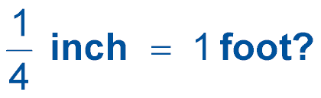
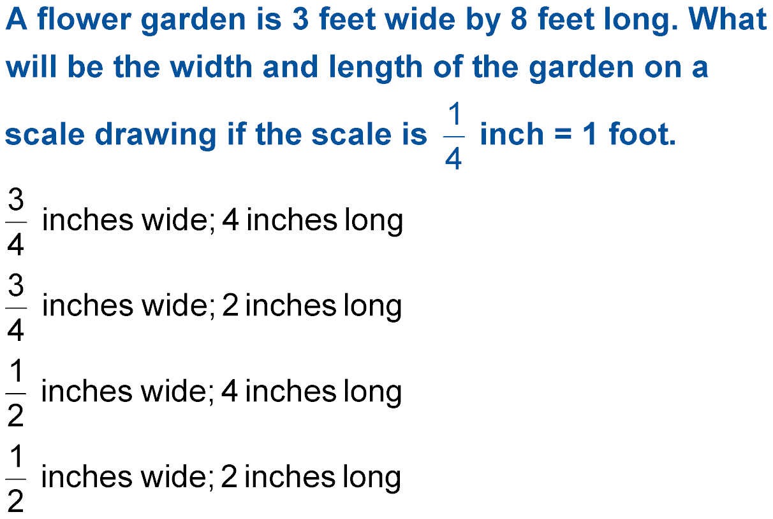
5-Minute Check 5
A flower garden is 3 feet wide by 8 feet long. What
will be the width and length of the garden on a
scale drawing if the scale is
A.
B.
C.
D.

Slide 8

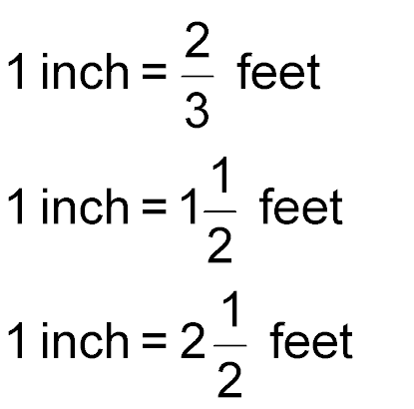
5-Minute Check 6
A model boat has a length of 42 inches. The actual length of the boat is 63 feet. What is the scale of the model?
A.
B.
C.
D. 1 inch = 12 feet

Slide 9


Then/Now
You have already used scales and scale factors to make scale drawings of objects. (Lesson 6–6)
Find missing measures of similar figures.
Use scale factors to solve problems.

Slide 10

Vocabulary
similar figures
corresponding parts
congruent

Slide 11
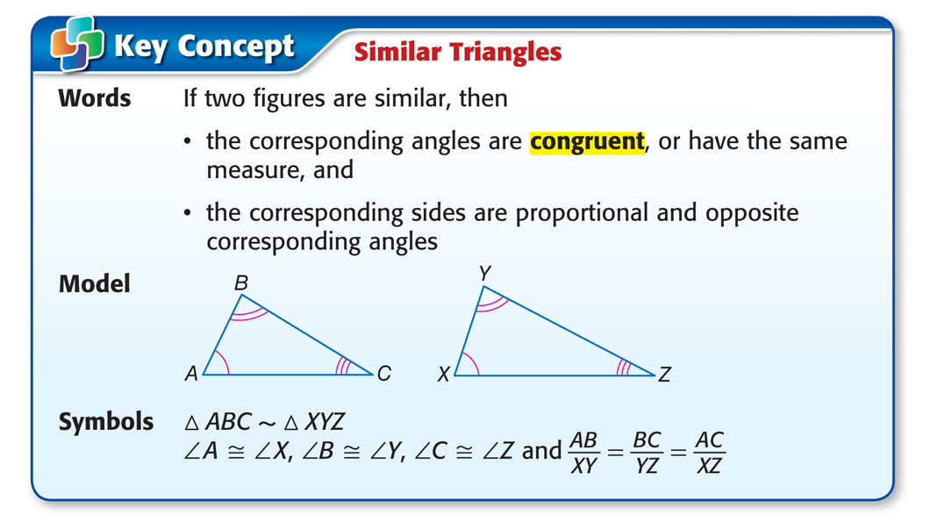
Concept

Slide 12
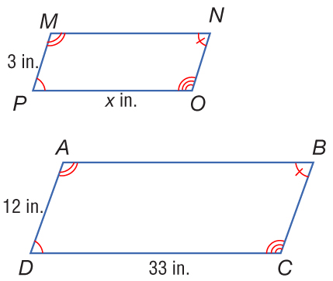
Example 1 A
Find Measures of Similar Figures
A. The figures are similar. Find the missing measure.
Since figure MNOP ~ figure ABCD, the corresponding angles are congruent and the corresponding sides are proportional.

Slide 13
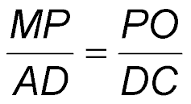
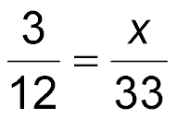
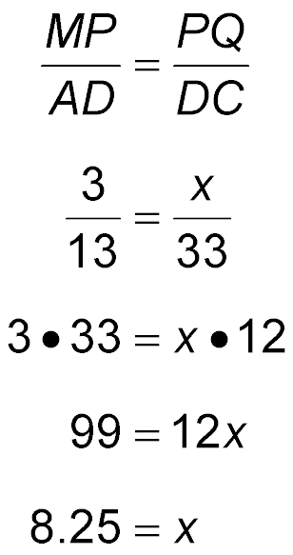
Example 1 A
Find Measures of Similar Figures
Write a proportion.
Replace MP with 3, AD with 12, PO with x, and DC with 33.
Find the cross products.
Multiply.
Divide each side by 12.
Answer: The value of x is 8.25.

Slide 14
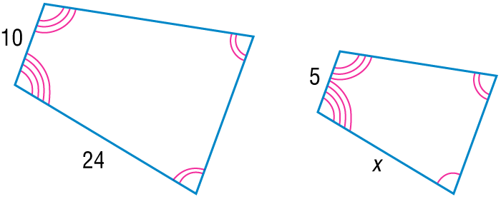
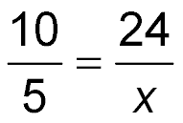
Example 1 A
Find Measures of Similar Figures
B. The figures are similar. Find the missing measure.
Sides measuring 10 and 5 are corresponding and sides measuring 24 and x are corresponding.
Write a proportion.
10x = 5 ● 24 Find the cross products.
10x = 120 Simplify.
x = 12 Divide each side by 10.
Answer: 12

Slide 15


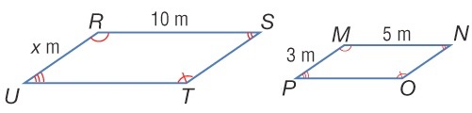
Example 1CYP A
A. The figures are similar. Find the missing measure.
A. 1.5 m
B. 6 m
C. 10 m
D. 16.7 m

Slide 16
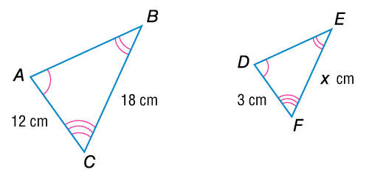
Example 1 B CYP
B. The figures are similar. Find the missing value of x.
A. 4.5
B. 8
C. 10
D. 18

Slide 17
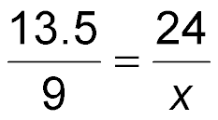
Example 2
Find Measures of Similar Figures
NESTED BOXES Nested boxes are a series of boxes that fit inside each other. The faces of the boxes are similar rectangles. A face on a larger box has a length of 24 centimeters and a width of 13.5 centimeters. If the width of a face on a smaller box is 9 centimeters, what is the length of the smaller box?
Write a proportion.
13.5x = 24 ● 9 Find the cross products.
13.5x = 216 Simplify.
x = 16 Divide each side by 13.5.

Slide 18
Example 2
Find Measures of Similar Figures
Answer: The length of the smaller box is
16 centimeters.

Slide 19
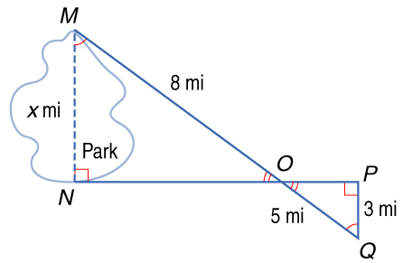
Example 2
MAPS In the figure, ΔMNO is similar to ΔQPO. Find the distance across the park.
A. 1.9 mi
B. 3.1 mi
C. 4.8 mi
D. 5.0 mi

Slide 20
End of the Lesson

